Slide 1
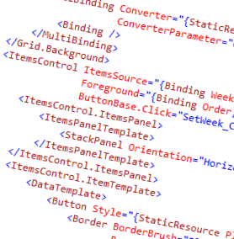
WPF and XAML
9 – MVVM with Caliburn.Micro

Slide 2
Overview
What is Caliburn.Micro?
A walkthrough of the elements of Caliburn.Micro

Slide 3
What is Caliburn.Micro?
MVVM Framework
Provides:
Convention based View and ViewModel mappings
Automatic wiring of UI elements to ViewModel properties (this is awesome)
Navigation
Heavy use of IoC
Composite ViewModels
Screens and conductors
UI Life cycle management
Actions (commands in disguise)
Event Aggregation
Super powerful and useful
Real world implementations of many hard UI patterns

Slide 4
How does it work?
Configuration
Convention
And Magic

Slide 5
Constructs
Bootstrapper
View and ViewModel conventions / ViewModel first
Actions
Event Aggregator
ViewModels for UI

Slide 6
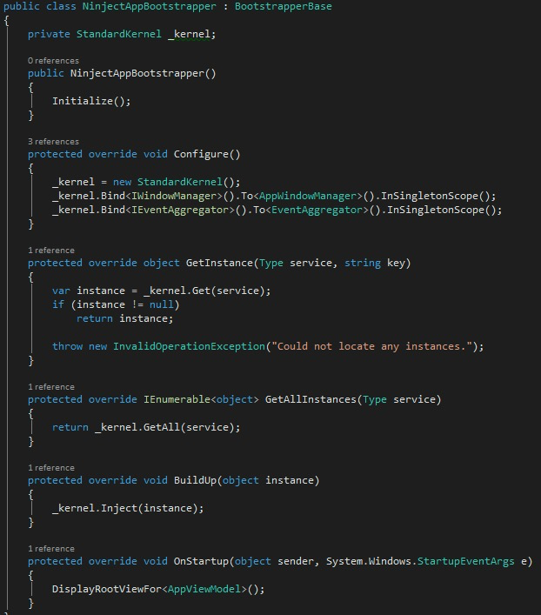
Bootstrapper
Where the app starts
You configure the container here

Slide 7

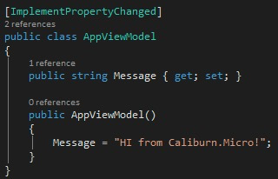
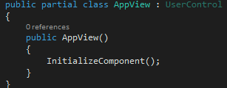
View and ViewModel conventions
View resolutions is viewmodel first
Views created automatically for ViewModels
Naming convention for classes and namespaces

Slide 8
Actions
Call methods in ViewModel from events fired in the View

Slide 9
Event Aggregator
Loosely couple subscription based communication within an application

Slide 10
ViewModels for the UI
Screens and Conductor’s
Provide lifecycle management for view models
Activation / deactivation of UI elements

Slide 11
Summary
Caliburn.Micro solves many of the headaches in a big MVVM app
But has a steep learning curve (on top of just MVVM and WPF)

Slide 12
Demo
Creating and using a basic Caliburn.Micro app

